Slide 1
Bootstrap
From W3schools.com

Slide 2
What is bootsrap?
Bootstrap is a free front-end framework for faster and easier web development
Bootstrap includes HTML and CSS based design templates for forms, buttons, tables, navigation, modals and many other, as well as optional JavaScript plugins.
Bootstrap also gives you the ability to easily create responsive designs.
Current version 4.1.0.

Slide 3
Why Use Bootstrap?
Easy to use: Anybody with just basic knowledge of HTML and CSS can start using Bootstrap
Responsive features: Bootstrap's responsive CSS adjusts to phones, tablets, and desktops
Mobile-first approach: In Bootstrap 3, mobile-first styles are part of the core framework
Browser compatibility: Bootstrap is compatible with all modern browsers (Chrome, Firefox, Internet Explorer, Safari, and Opera)
If you want to download and host Bootstrap, go to getbootstrap.com, and follow the instructions there.

Slide 4
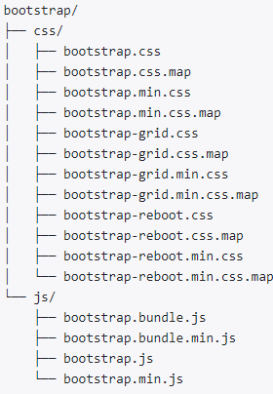
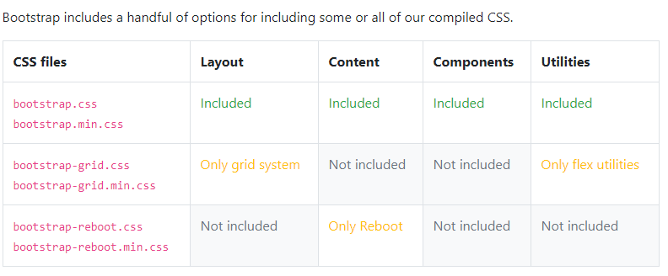
Understanding the File Structure
compiled version of Bootstrap provides compiled CSS and JS files(bootsrap.*), compiled and minified CSS and JS(bootsrap.min.*),

Slide 5

Creating Your First Web Page with Bootstrap
Step 1: Creating a Basic HTML file
<!DOCTYPE html>
<html>
<head>
<meta charset="utf-8">
<title>Basic HTML File</title>
</head>
<body>
<h1>Hello, world!</h1>
</body>
</html>

Slide 6

Cont’d
Step 2: Making this HTML File a Bootstrap Template
<!DOCTYPE html>
<html>
<head>
<meta charset="utf-8">
<title>Basic Bootstrap Template</title>
<link rel="stylesheet" type="text/css" href="C:/Exercise/bootstrap-3.3.7-dist/css/bootstrap.min.css">
</head>
<body>
<h1>Hello, world!</h1>
<script src="C:/Exercise/bootstrap-3.3.7-dist/js/bootstrap.min.js"></script>
</body>
</html>

Slide 7

Containers
There are two container classes to choose from:
The .container class provides a responsive fixed width container
The .container-fluid class provides a full width container, spanning the entire width of the viewport

Slide 8
Example
<!DOCTYPE html>
<html lang="en">
<head>
<title>Bootstrap Example</title>
<meta charset="utf-8">
<link rel="stylesheet" type="text/css" href="C:/Exercise/bootstrap-3.3.7-dist/css/bootstrap.min.css">
<script src="C:/Exercise/bootstrap-3.3.7-dist/js/bootstrap.min.js"></script>
</head>
<body>
<div class="container-fluid">
<h1>My First Bootstrap Page</h1>
<p>This is some text.</p>
</div>
</body>
</html>

Slide 9
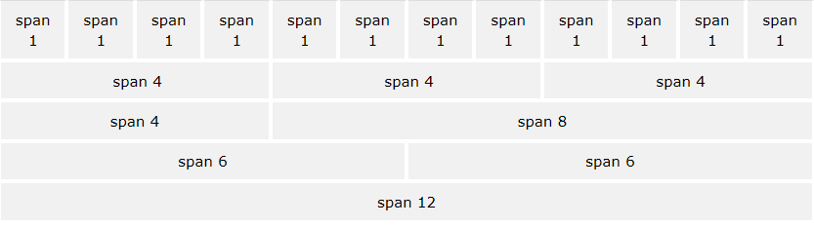
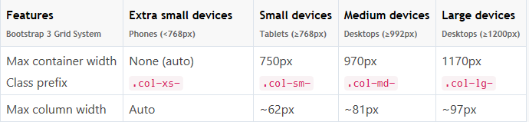
Bootstrap Grids
Bootstrap's grid system allows up to 12 columns across the page.
If you do not want to use all 12 columns individually, you can group the columns together to create wider columns:

Slide 10
Examples
Three Equal Columns
<div class="row">
<div class="col-sm-4" style="background-color:lavender;">.col-sm-4</div>
<div class="col-sm-4" style="background-color:lavenderblush;">.col-sm-8</div>
<div class="col-sm-4" style="background-color:lavender;">.col-sm-4</div>
</div>
Two Unequal Columns
<div class="row"> <div class="col-sm-4” style="background-color:lavender;">.col-sm-4</div> <div class="col-sm-8” style="background-color:lavenderblush;">.col-sm-8</div> </div>

Slide 11
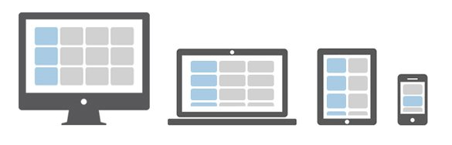
Creating Multi-Column Layouts
control how your website layout will render on different types of devices that have different screen sizes like cell phones, tablets, desktops, etc. Let's consider the following illustration.
In the above illustration there are total 12 content boxes in all devices, but its placement varies according to the device screen size, like in mobile device the layout is rendered as one column grid layout which has 1 column and 12 rows placed above one another, whereas in tablet it is rendered as two column grid layout which has 2 columns and 6 rows.

Slide 12
Example 1
<!DOCTYPE html>
<html lang="en">
<head>
<link rel="stylesheet" type="text/css" href="C:/Exercise/bootstrap-3.3.7-dist/css/bootstrap.min.css">
<script src="C:/Exercise/bootstrap-3.3.7-dist/js/bootstrap.min.js"></script>
<style type="text/css">
p{
padding: 50px;
font-size: 32px;
font-weight: bold;
text-align: center;
background: #dbdfe5;
}
</style>
</head>

Slide 13
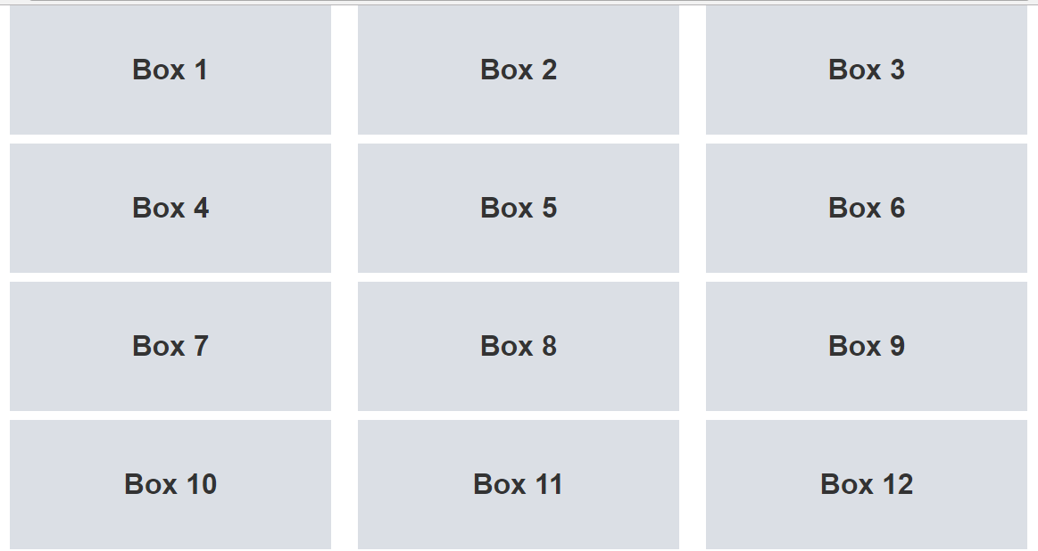
Example1(cont’d)
<body>
<div class="container">
<div class="row">
<div class="col-md-4"><p>Box 1</p></div>
<div class="col-md-4"><p>Box 2</p></div>
<div class="col-md-4"><p>Box 3</p></div>
<div class="col-md-4"><p>Box 4</p></div>
<div class="col-md-4"><p>Box 5</p></div>
<div class="col-md-4"><p>Box 6</p></div>
<div class="col-md-4"><p>Box 7</p></div>
<div class="col-md-4"><p>Box 8</p></div>
<div class="col-md-4"><p>Box 9</p></div>
<div class="col-md-4"><p>Box 10</p></div>
<div class="col-md-4"><p>Box 11</p></div>
<div class="col-md-4"><p>Box 12</p></div>
</div>
</div>
</body>
</html>

Slide 14
Example1(cont’d)
If height of any column is taller than the other it doesn't clear properly and break the layout. To fix this, use the combination of a .clearfix class and the responsive utility classes.
<div class="container">
<div class="row">
<div class="col-md-4"><p>Box 1</p></div>
<div class="col-md-4"><p>Box 2</p></div>
<div class="col-md-4"><p>Box 3</p></div>
<div class="clearfix visible-md-block"></div>
…

Slide 15
Example 2
<div class="container">
<div class="row">
<div class="col-sm-6 col-md-4"><p>Box 1</p></div>
<div class="col-sm-6 col-md-4"><p>Box 2</p></div>
<div class="clearfix visible-sm-block"></div>
<div class="col-sm-6 col-md-4"><p>Box 3</p></div>
<div class="clearfix visible-md-block"></div>
<div class="col-sm-6 col-md-4"><p>Box 4</p></div>
<div class="clearfix visible-sm-block"></div>
<div class="col-sm-6 col-md-4"><p>Box 5</p></div>
<div class="col-sm-6 col-md-4"><p>Box 6</p></div>
<div class="clearfix visible-sm-block"></div>
<div class="clearfix visible-md-block"></div>
<div class="col-sm-6 col-md-4"><p>Box 7</p></div>
<div class="col-sm-6 col-md-4"><p>Box 8</p></div>
<div class="clearfix visible-sm-block"></div>
<div class="col-sm-6 col-md-4"><p>Box 9</p></div>
<div class="clearfix visible-md-block"></div>
<div class="col-sm-6 col-md-4"><p>Box 10</p></div>
<div class="clearfix visible-sm-block"></div>
<div class="col-sm-6 col-md-4"><p>Box 11</p></div>
<div class="col-sm-6 col-md-4"><p>Box 12</p></div>
</div>
</div>

Slide 16
Nesting of Grid Columns
<!DOCTYPE html>
<html lang="en">
<head>
<link rel="stylesheet" type="text/css" href="C:/Exercise/bootstrap-3.3.7-dist/css/bootstrap.min.css">
<script src="C:/Exercise/bootstrap-3.3.7-dist/js/bootstrap.min.js"></script>
<style type="text/css">
/* Some custom styles to beautify this example */
.main-content{
min-height: 330px;
background: #dbdfe5;
}
.sidebar-content{
min-height: 150px;
margin-bottom: 30px;
background: #b4bac0;
}
</style>
</head>
<body>

Slide 17

Nesting of Grid Columns(con’td)
<div class="container">
<div class="row">
<div class="col-xs-8">
<div class="main-content"></div>
</div>
<div class="col-xs-4">
<!--Nested rows within a column-->
<div class="row">
<div class="col-xs-12">
<div class="sidebar-content"></div>
</div>
</div>
<div class="row">
<div class="col-xs-12">
<div class="sidebar-content"></div>
</div>
</div>
</div>
</div>
</div>
</body>
</html>

Slide 18
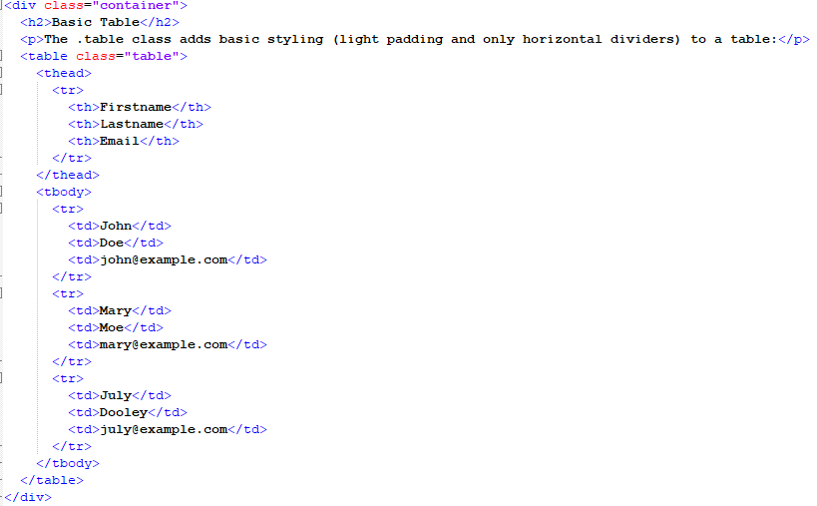
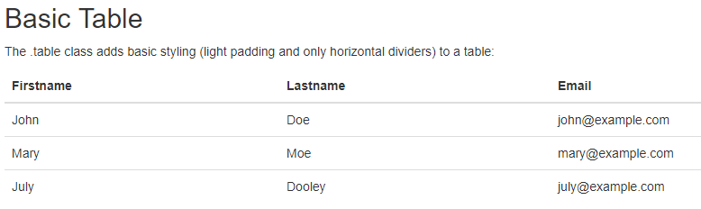
Tables
Basic Table Example

Slide 19
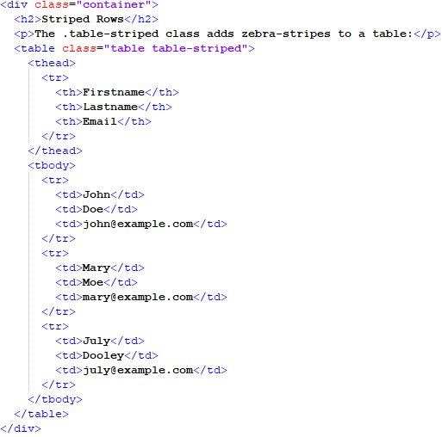
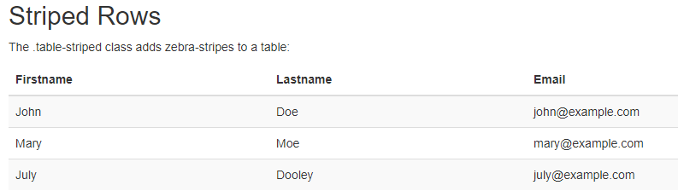
Example: Striped

Slide 20

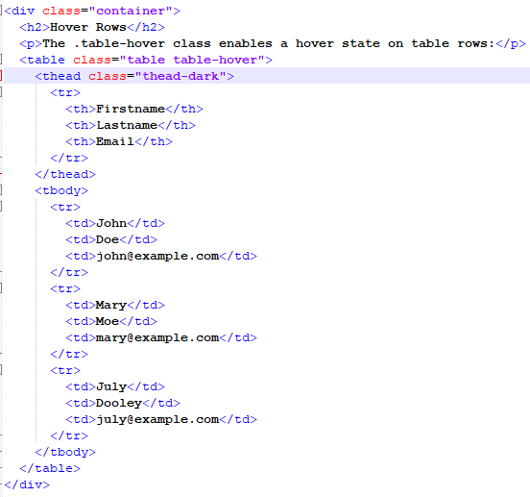
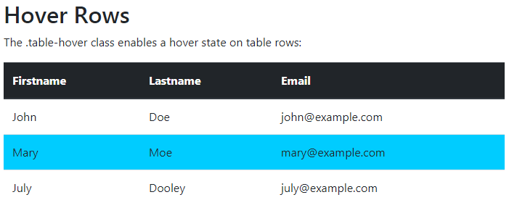
Example: hover

Slide 21
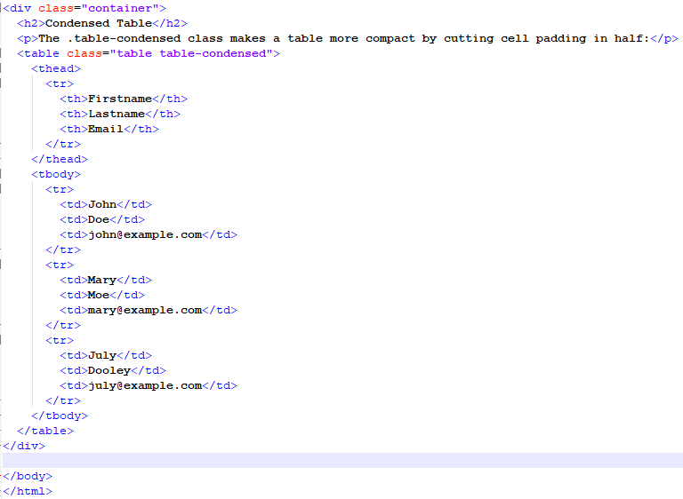
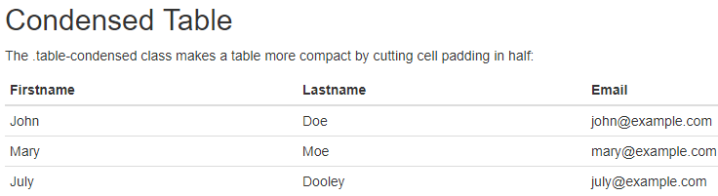
Example: condensed

Slide 22
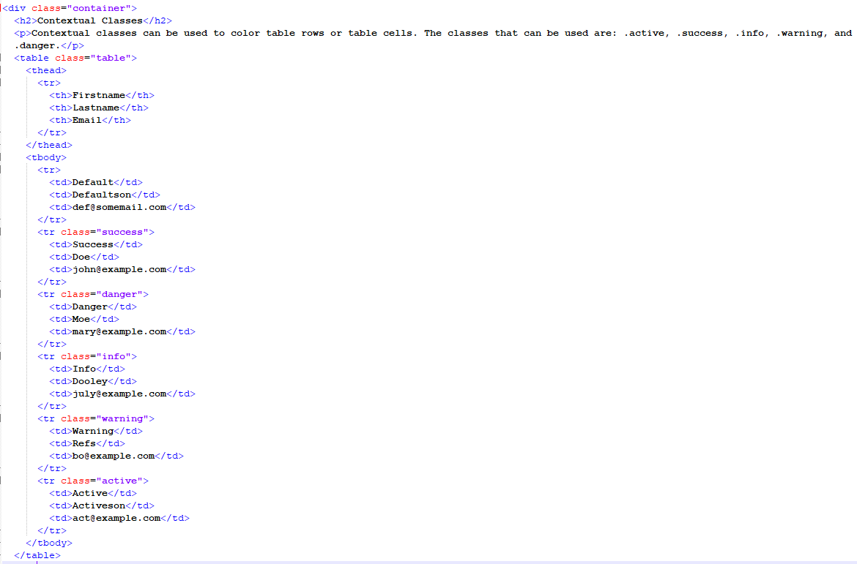
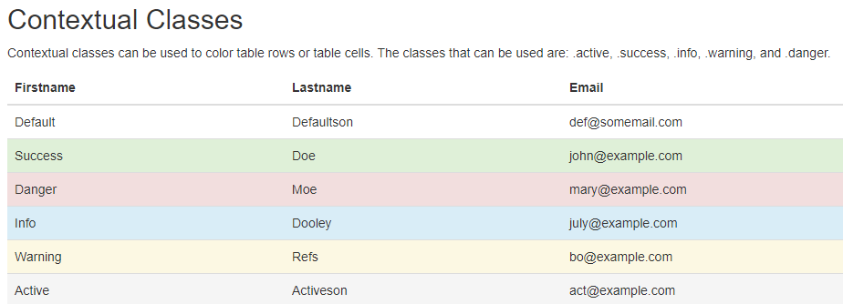
Example: contextual class with tables

Slide 23
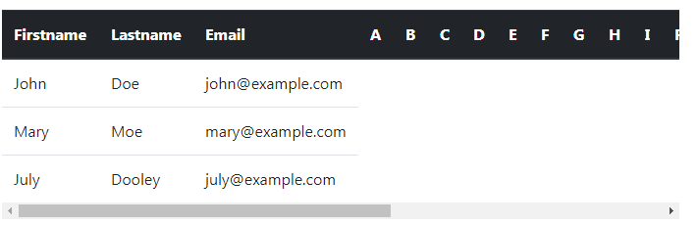
Example: responsive tables
Responsive tables allow tables to be scrolled horizontally with ease
<div class="table-responsive">
<table class="table">
...
</table>
</div>

Slide 24

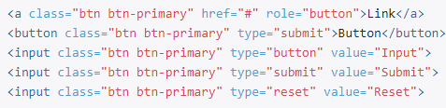

Buttons
<button type="button" class="btn btn-primary">Primary</button>
<button type="button" class="btn btn-secondary">Secondary</button>
<button type="button" class="btn btn-success">Success</button>
<button type="button" class="btn btn-danger">Danger</button>
<button type="button" class="btn btn-warning">Warning</button>
<button type="button" class="btn btn-info">Info</button>
<button type="button" class="btn btn-light">Light</button>
<button type="button" class="btn btn-dark">Dark</button>
<button type="button" class="btn btn-link">Link</button>
The .btn classes are designed to be used with the <button> element. However, you can also use these classes on <a> or <input> elements

Slide 25
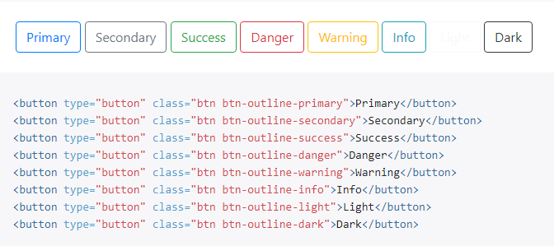
Outline buttons
In need of a button, but not the hefty background colors they bring?

Slide 26
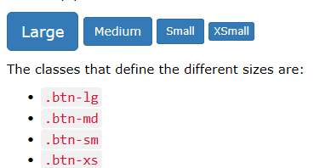
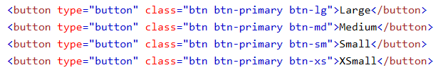
Button Sizes
Button Sizes

Slide 27
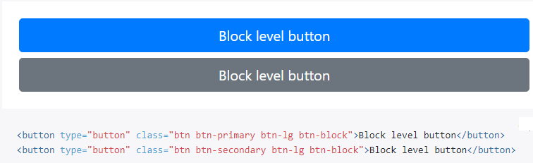
Block Level Buttons
Create block level buttons—those that span the full width of a parent—by adding .btn-block.

Slide 28
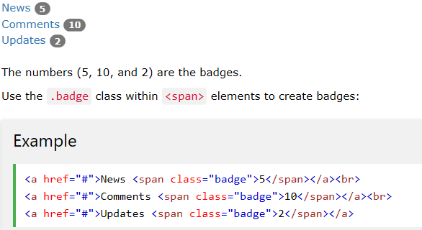
Badges
Badges are numerical indicators of how many items are associated with a link:

Slide 29
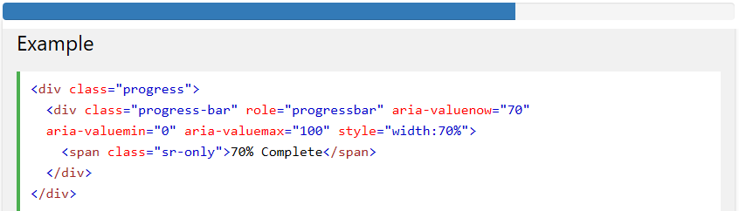
Progress Bars
Basic Progress Bar:
A progress bar can be used to show a user how far along he/she is in a process.
Bootstrap provides several types of progress bars.
To create a default progress bar, add a .progress class to <div> element:

Slide 30
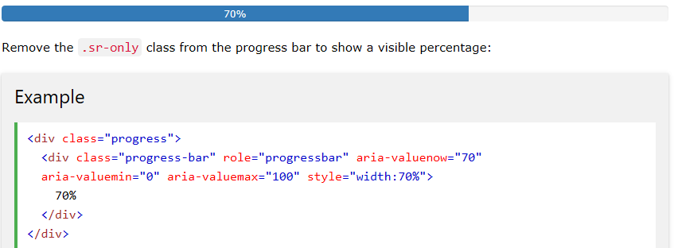
Progress Bar With Label

Slide 31
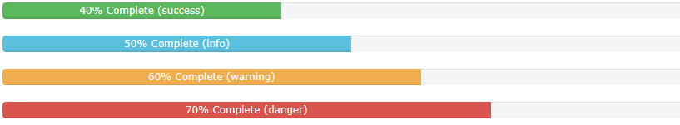
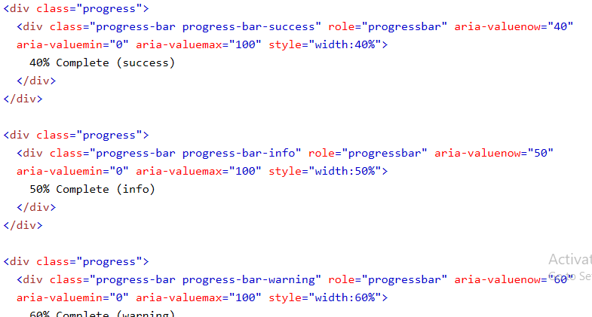
Colored Progress Bars
The contextual classes that can be used with progress bars are:
.progress-bar-success
.progress-bar-info
.progress-bar-warning
.progress-bar-danger

Slide 32
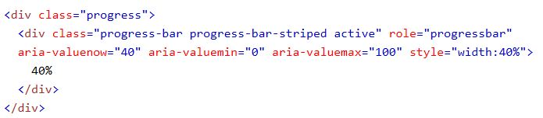
Animated Progress Bar
Add .active to animate the progress bar

Slide 33

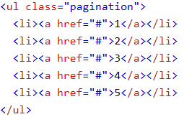
Basic Pagination
If you have a web site with lots of pages, you may wish to add some sort of pagination to each page.
A basic pagination in Bootstrap looks like this:
To create a basic pagination, add the .pagination class to an <ul> element.

Slide 34
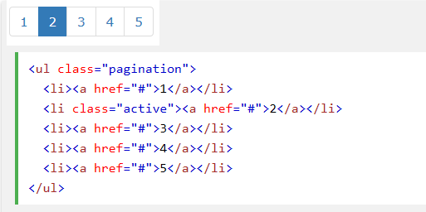
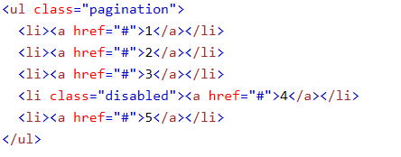

Active State
Disabled State: A disabled link cannot be clicked:

Slide 35


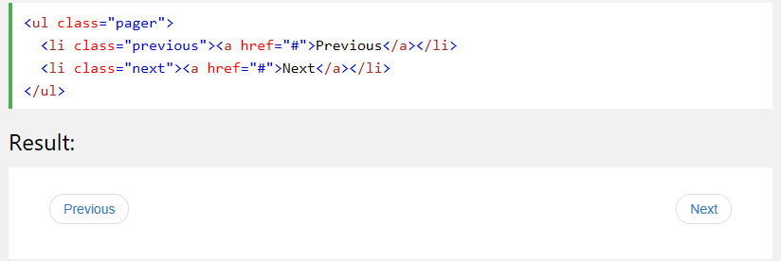
Pager
Pager provides previous and next buttons (links).
To create a basic pagination, add the .pager class to an <ul> element.
Align Buttons: use .previous and .next classes to align each button to the sides of the page.

Slide 36
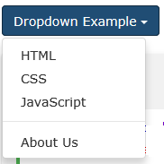
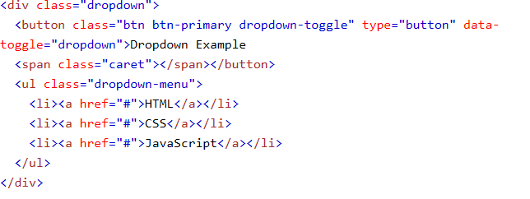
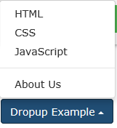
Dropdown and Drop up
A dropdown menu is a toggleable menu that allows the user to choose one value from a predefined list:
Drop up

Slide 37
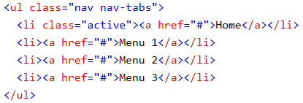
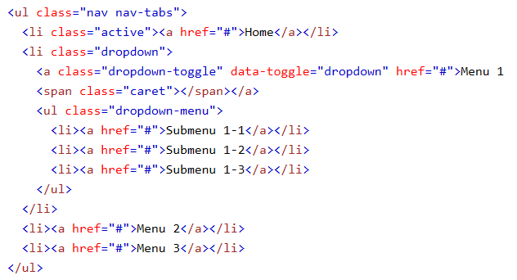
Tabs
Tabs With Dropdown Menu

Slide 38

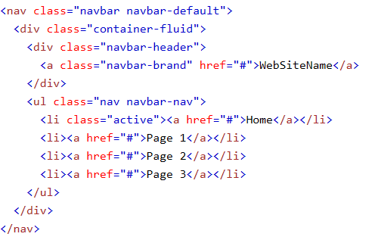
Navigation Bars
A navigation bar is a navigation header that is placed at the top of the page:

Slide 39
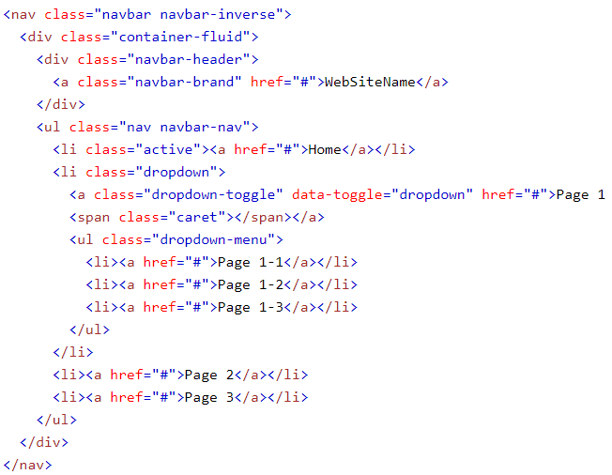
Navigation Bar With Dropdown

Slide 40
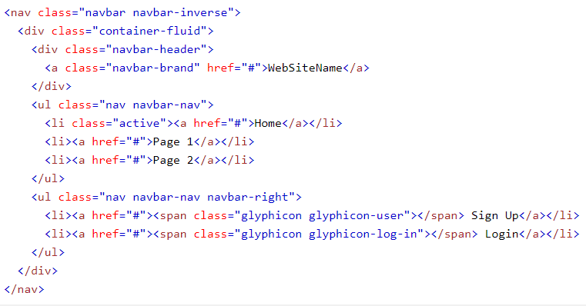
Right-Aligned Navigation Bar
The .navbar-right class is used to right-align navigation bar buttons.
In the following example we insert a "Sign Up" button and a "Login" button to the right in the navigation bar. We also add a glyphicon on each of the two new buttons

Slide 41
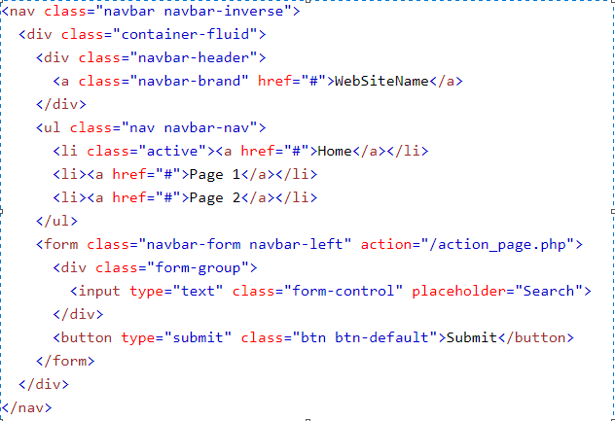
Navbar Forms
To add form elements inside the navbar, add the .navbar-form class to a form element and add an input(s).

Slide 42
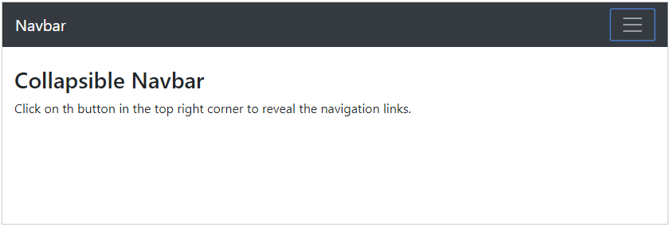
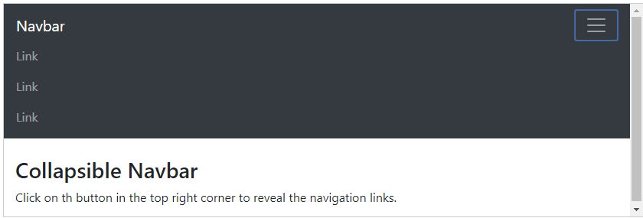
Collapsing The Navigation Bar
The navigation bar often takes up too much space on a small screen.
We should hide the navigation bar; and only show it when it is needed.

Slide 43
Forms
Bootstrap provides three types of form layouts:
Vertical form (this is default)
Horizontal form
Inline form
Standard rules for all three form layouts:
Wrap labels and form controls in <div class="form-group">
Add class .form-control to all textual <input>, <textarea> and <select> elements.

Slide 44
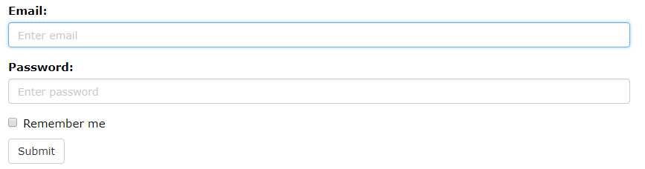
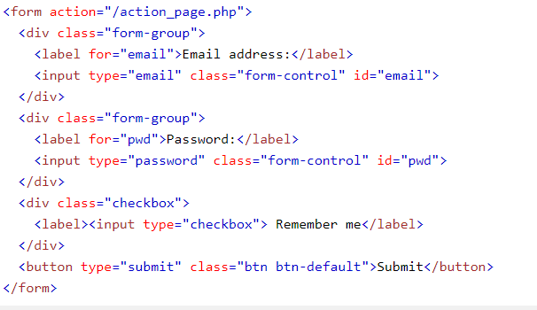
Bootstrap Vertical Form (default)

Slide 45
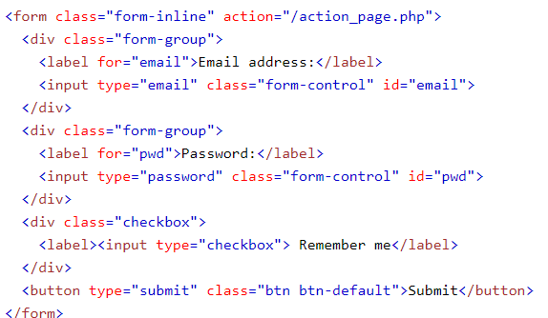
Bootstrap Inline Form
Add class .form-inline to the <form> element

Slide 46
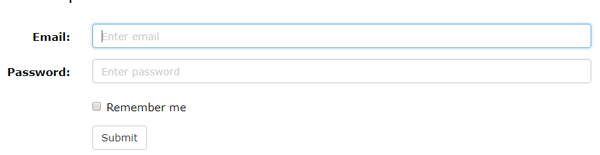
Bootstrap Horizontal Form
Additional rules for a horizontal form:
Add class .form-horizontal to the <form> element
Add class .control-label to all <label> elements

Slide 47
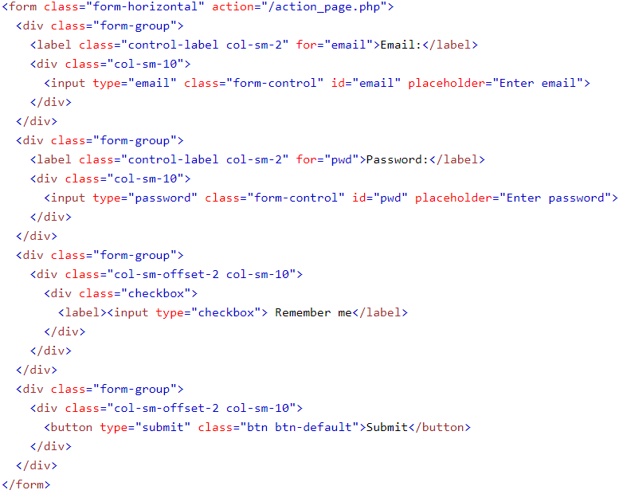
Example: Horizontal Form

Slide 48
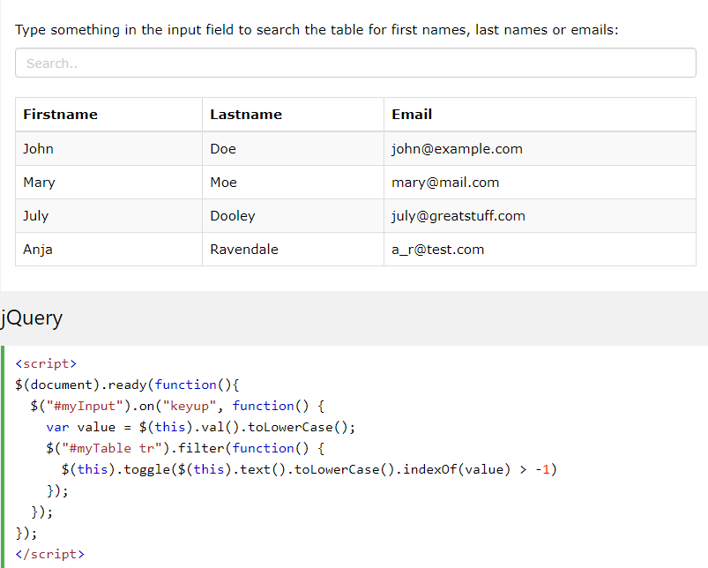
Filters
Filter Tables

Slide 49
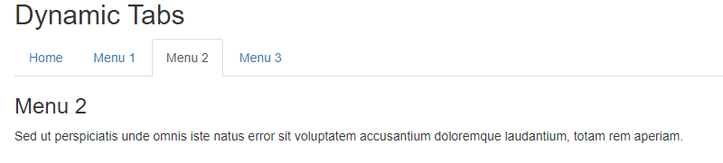


Slide 50
More about bootsrap?
Visit www.W3schools.com

